Slide 1
Strong-Style Pairing
Llewellyn Falco & Maaret Pyhäjärvi
Setup
Paper
Please write the languages you speak
Laptop (if you have one, not required)
Please setup an IDE of your choice
English Finnish Swedish
Paper
Please write the language of the environment
JAVA

Slide 2
Strong-Style Pairing
Llewellyn Falco & Maaret Pyhäjärvi

Slide 3
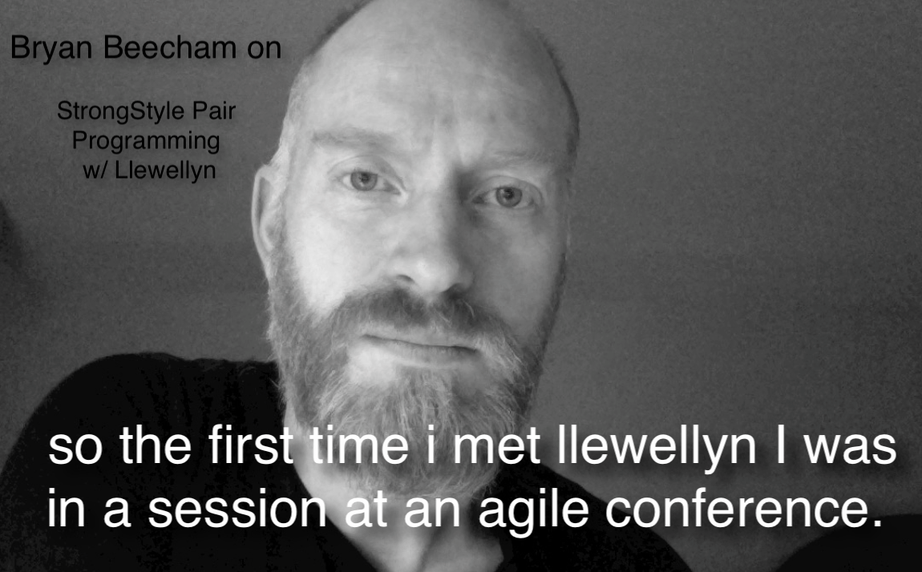


Slide 4
“For an idea to go from your head to the computer it must go through someone else’s hands”

Slide 5
Comparison
Strong Style
Traditional
I have an idea…
Please take the keyboard
I have an idea…
Give me the keyboard

Slide 6
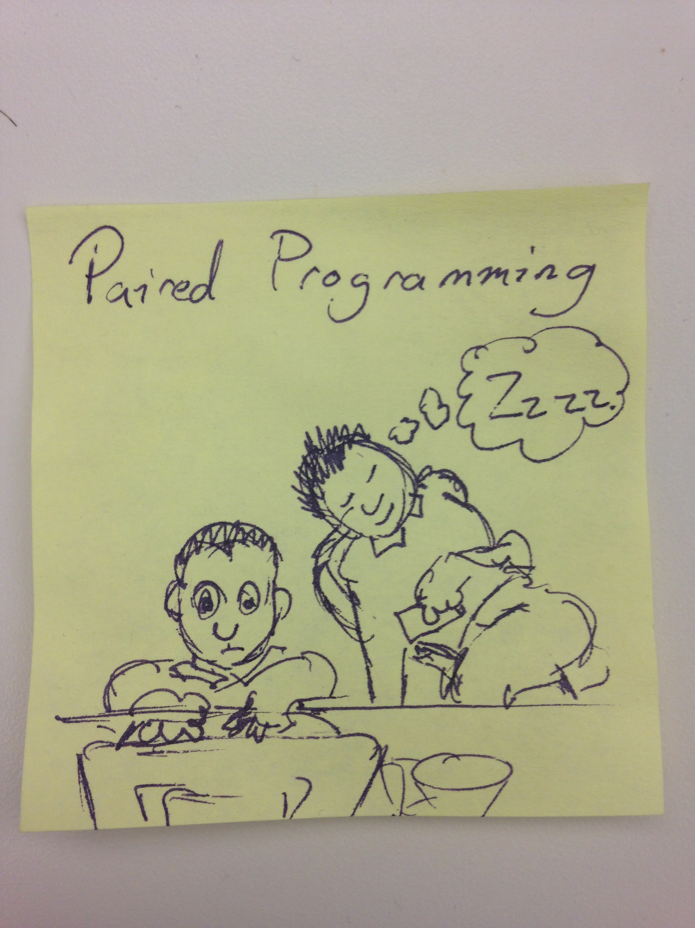

Slide 7
Strong-Style Experience (Phone Exercise)

Slide 8
Highest level of abstraction Intent Location Details

Slide 9
= vs. ==
assign vs. compare

Slide 10
Strong-Style Experience (Phone Exercise reversed)

Slide 11
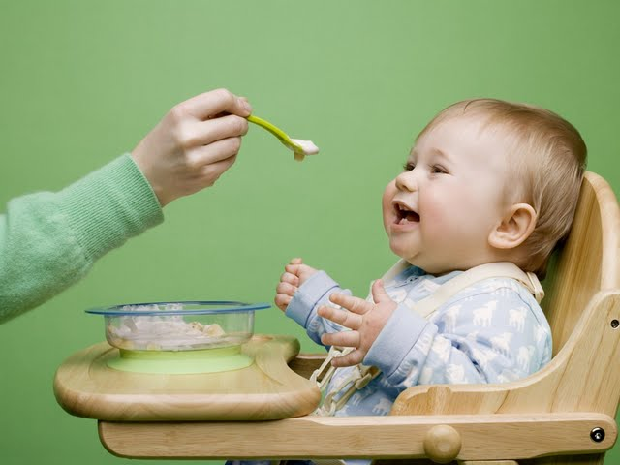
Feeding the driver
Notes:
Not while chewing
Avoid chocking
You are responsible for taking care of the driver

Slide 12
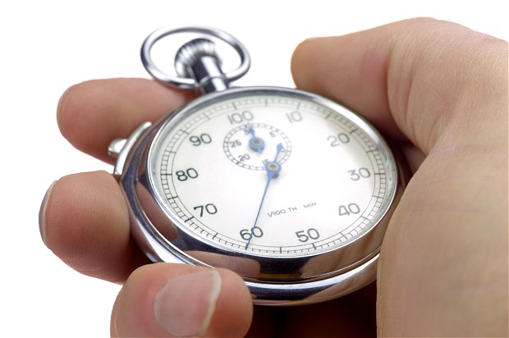
Establishing Trust

Slide 13
Navigation Exercise
If you are working on a task or doing test-first development, it is very useful to have an example written on a whiteboard. The examples should be very simple, and only show one path at a time. This means you can not use conditional words like "or", "if", "depending", or "maybe".

Slide 14
Navigation Exercise
If you are working on a task or doing test-first development, it is very useful to have an example written on a whiteboard. The examples should be very simple, and only show one path at a time. This means you can not use conditional words like "or", "if", "depending", or "maybe". If there is an example, it might take many turns before its finished, and having it on the board will give guidance for the whole team on what they need to do as each new navigator takes over and continues on the task. Examples should make you feel like the person telling the example actually did the thing yesterday.

Slide 15
Learning as a driver (Language demo) traditional strong-style

Slide 16
Learning as a driver (Language Exercise) traditional strong-style

Slide 17
Being a good driver/navigator

Slide 18
Rules of Improv Agree Yes, and… Statements there are no mistakes

Slide 19
Rules of Pairing Try it Yes, and… Do first, explain later Look for wins

Slide 20
Problems that dissolve
Beginner / experienced
Sleeping
Engagement
Self worth

Slide 21
How to start pairing.

Slide 22
Trust is built on Many small successes

Slide 23
Coding exercise

Slide 24
Fizz Buzz 1, 2, Fizz, 4, Buzz, Fizz, 7, 8, Fizz, Buzz, 11, Fizz, 13, 14, FizzBuzz, 16, 17, Fizz, 19, Buzz

Slide 25
Mobbing exercise

Slide 26
Reese’s

Slide 27
Switching on time on task on idea

Slide 28
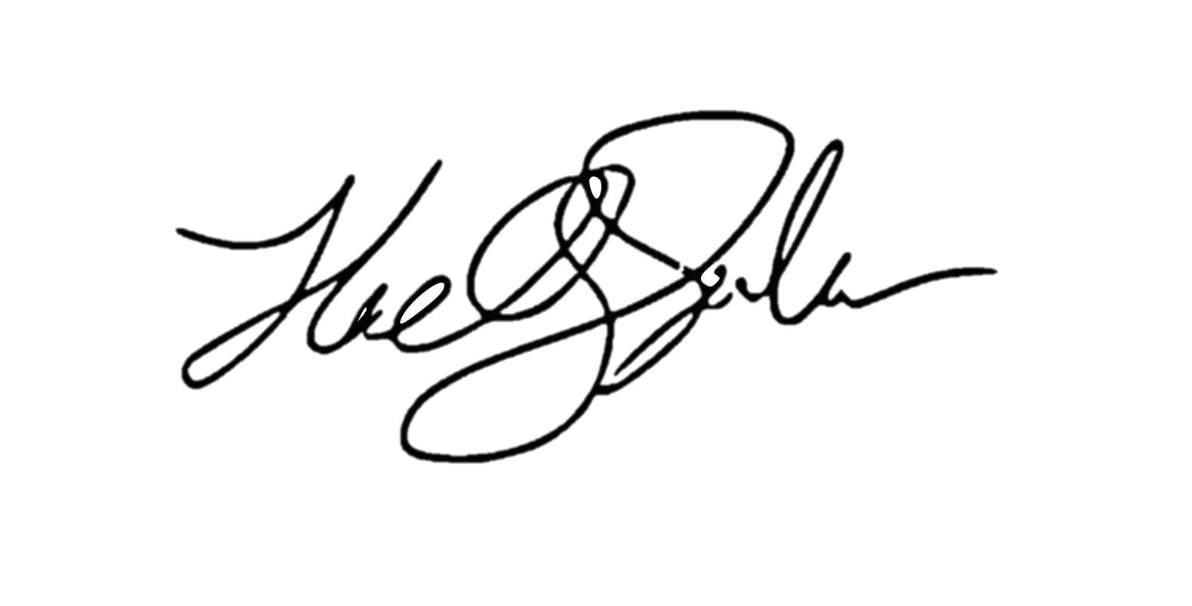
ROI of spending 1 hour a day
learning for a 1% increase
5x (1 year)
4x (10 months)
Output
2x (6 months)
3x (8.5 months)
28 days
Llewellyn Falco

Slide 29
Homework Assignment

Slide 30
Common Problems

Slide 31
References podcast – pairing w/ llew llew strong style blog - pairing

Slide 32
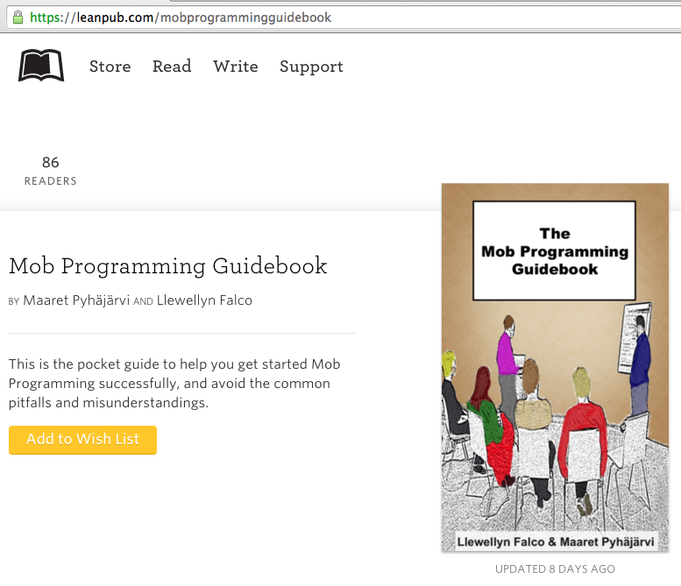
#MobProgrammingGuidebook

Slide 33
Thank you.
@maaretp
@LlewellynFalco
(please connect with us through Twitter or LinkedIn)

